Slide 1
💫StarCoder
May the Source Be With You!
Authors: Raymond Li, Loubna Ben Allal, Yangtian Zi, Niklas Muennighoff, Denis Kocetkov, Chenghao Mou, Marc Marone, Christopher Akiki, Jia Li, Jenny Chim, Qian Liu, Evgenii Zheltonozhskii, Terry Yue Zhuo, Thomas Wang, Olivier Dehaene, Mishig Davaadorj, Joel Lamy-Poirier, João Monteiro, Oleh Shliazhko, Nicolas Gontier, Nicholas Meade, Armel Zebaze, Ming-Ho Yee, Logesh Kumar Umapathi, Jian Zhu, Benjamin Lipkin, Muhtasham Oblokulov, Zhiruo Wang, Rudra Murthy, Jason Stillerman, Siva Sankalp Patel, Dmitry Abulkhanov, Marco Zocca, Manan Dey, Zhihan Zhang, Nour Fahmy, Urvashi Bhattacharyya, Wenhao Yu, Swayam Singh, Sasha Luccioni, Paulo Villegas, Maxim Kunakov, Fedor Zhdanov, Manuel Romero, Tony Lee, Nadav Timor, Jennifer Ding, Claire Schlesinger, Hailey Schoelkopf, Jan Ebert, Tri Dao, Mayank Mishra, Alex Gu, Jennifer Robinson, Carolyn Jane Anderson, Brendan Dolan-Gavitt, Danish Contractor, Siva Reddy, Daniel Fried, Dzmitry Bahdanau, Yacine Jernite, Carlos Muñoz Ferrandis, Sean Hughes, Thomas Wolf, Arjun Guha, Leandro von Werra, Harm de Vries

Slide 2
Background
Why Do This?
Not many open code models!
Salesforce CodeGen was the largest, with 16B params
Datasets used for training code models were not well described
Codex/Copilot: “all of GitHub”
CodeGen: Unspecified repos pulled from Google’s GitHub BigQuery
This leads to copyright and ethics concerns
How can I tell if the model spits out someone’s copyrighted code?

Slide 3
Background
What can you do with a code model?
Most obvious: code completion! (Like Copilot)
But also:
Program repair / Vulnerability fixing (https://arxiv.org/abs/2112.02125)
Explaining and summarizing code
Translating between programming languages
Finding similar code, semantic code search (e.g., with embeddings)
Solve problems that require more precise answers
What does this mean?

Slide 4
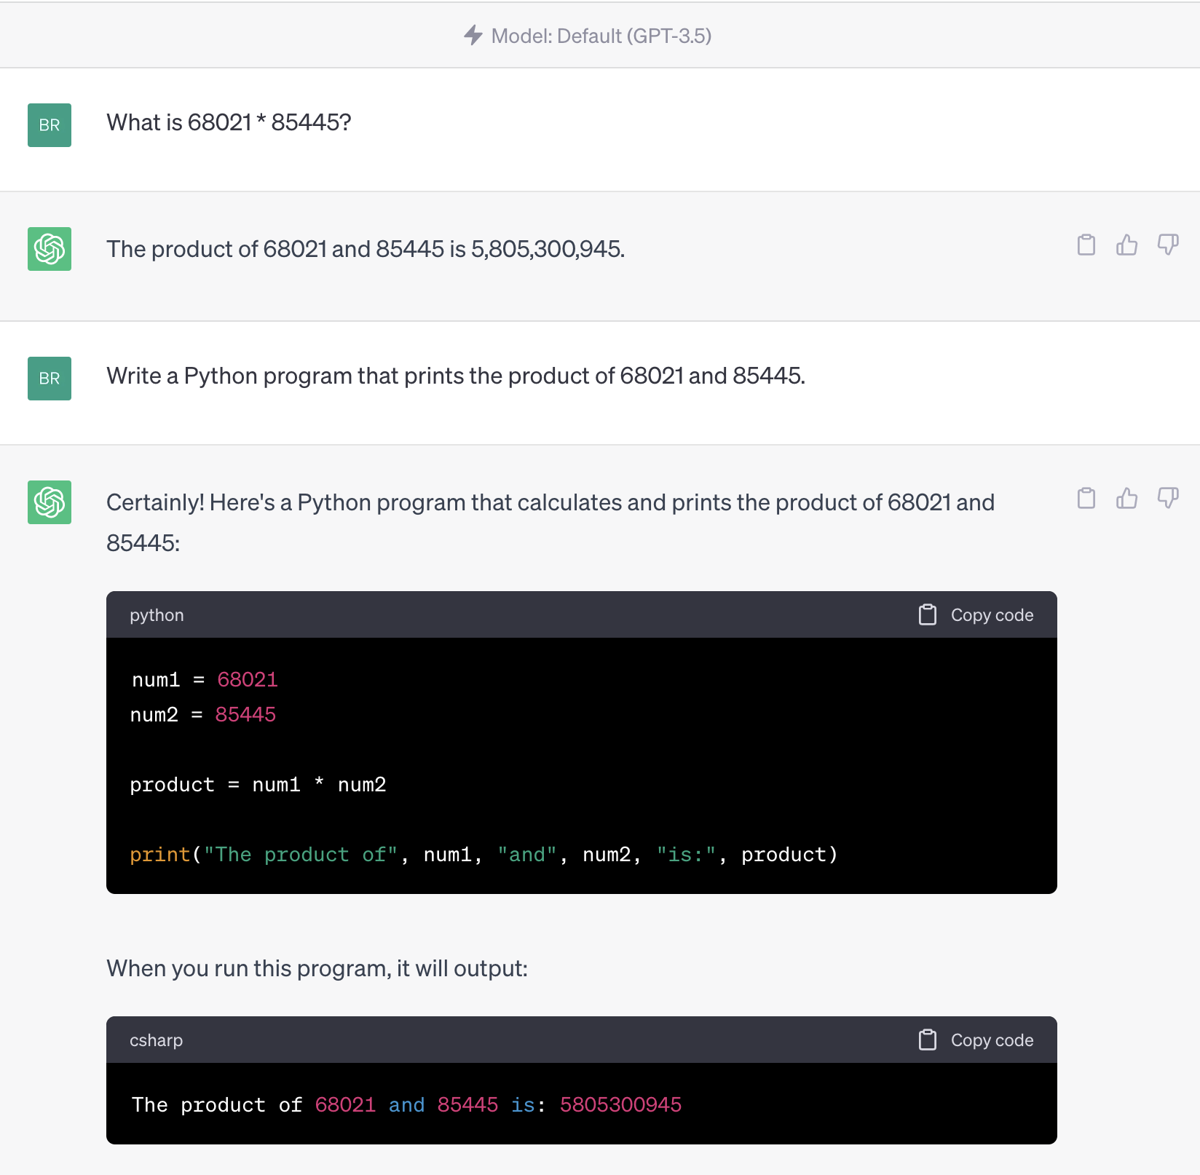
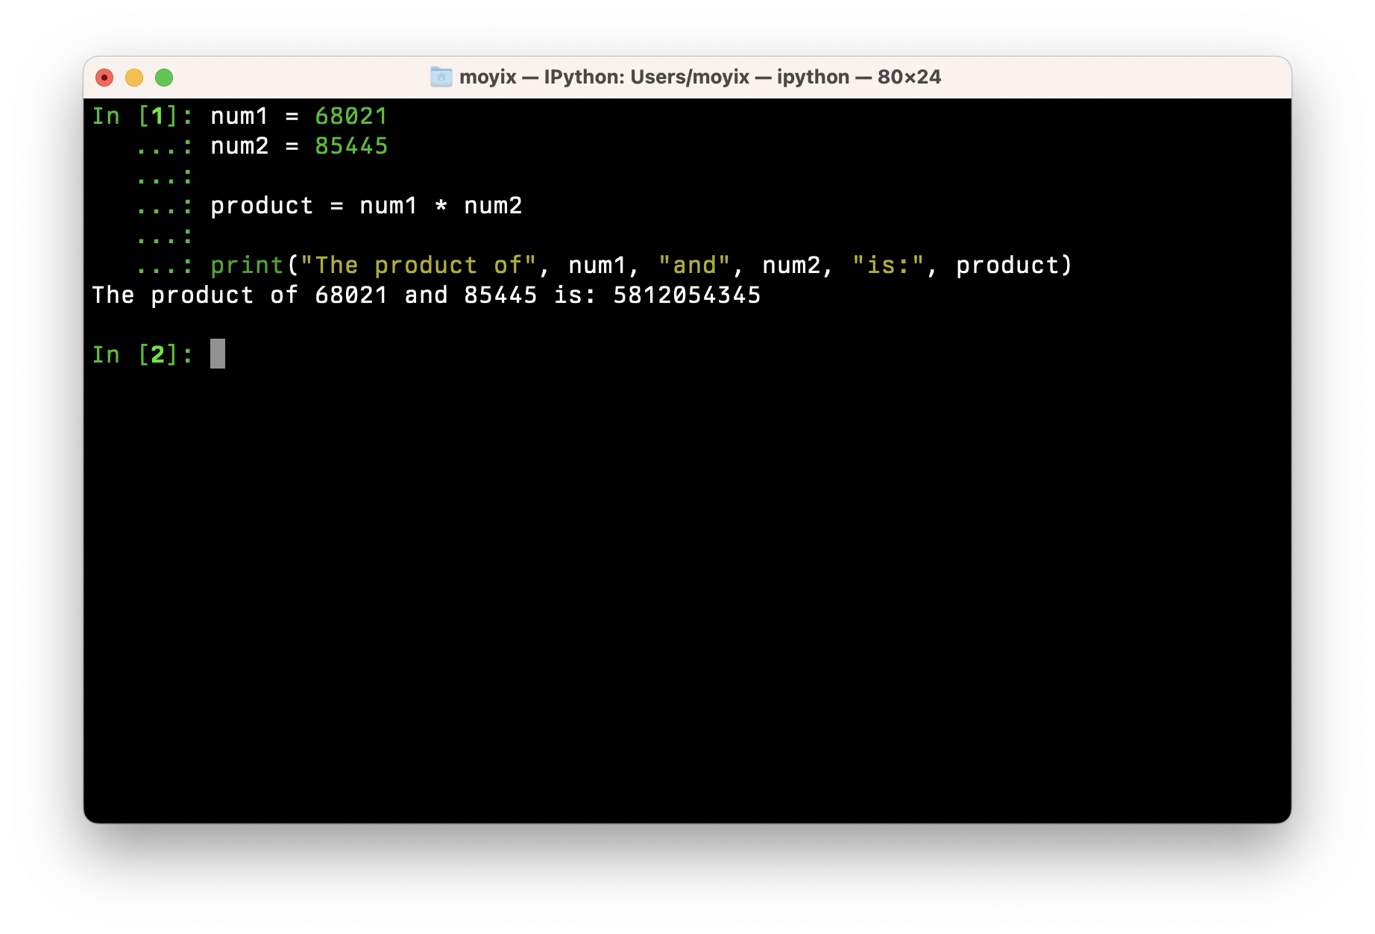
Letting LLMs Use Tools
Should be 5,812,054,345
Correct!

Slide 5
The BigCode Project
🤗
International collaboration led by HuggingFace and ServiceNow
Timeline:
Started in September 2022
Small model (SantaCoder, 1.1B params) released in December 2022
Full model (StarCoder, 15.5B params) released May 4, 2023!
Goal: to build a highly capable, open code model on par with Codex Cushman
But with permissively licensed data and opt-out

Slide 6
Dataset: The Stack v1.2
The Stack: https://arxiv.org/abs/2211.15533
“Permissively Licensed” code: licenses with very few restrictions on use
No GPL
Tools to check if your code is included, and opt-out: https://huggingface.co/spaces/bigcode/in-the-stack
Code: 86 programming languages
Jupyter Notebooks (Code + Markdown Text)
Git Commits and GitHub Issues
Dataset was deduplicated and PII redacted

Slide 7
Data Formatting
Code: includes filename and number of GitHub stars: <reponame>REPONAME<filename>FILENAME<gh_stars>STARS\nCode<eos>
Issues: <issue_start>title + USERID: comment<issue_comment>USERID: Comment ... <issue_closed (optional)> <eos>
Jupyter: <jupyter_start><jupyter_text>TEXT<jupyter_code>CODE <jupyter_output>OUTPUT<jupyter_text> ...
Git Commits: <commit_before>code<commit_msg>text<commit_after>code<eos>

Slide 8
Model Info
StarCoder is a GPT2-style decoder-only model with:
Absolute positional encodings
Context window of 8192 tokens
~700 lines of code, or ~24,000 characters
Multi-query attention (MQA)
Gives big memory savings => larger batch sizes
15.5 billion parameters (~32GB of GPU memory required)
Fill-in-the-Middle

Slide 9
Fill in the Middle
Initially introduced by OpenAI in “Efficient Training of Language Models to Fill in the Middle” (https://arxiv.org/abs/2207.14255)
Simple trick: for some of the training data, take the sample and rearrange it so that the model has to predict the middle instead of the next token
Example: public static void main(String[] args) { Becomes: <fim_start>public static void main(<fim_end>) {<fim_middle>String[] args
Now at inference time we can ask the model to generate code with knowledge of what comes before and after the cursor

Slide 10
Model Training
StarCoderBase model was trained on 1 trillion tokens from The Stack
StarCoder was then fine-tuned on an additional 35 billion tokens of Python code
StarCoder does much better on Python tasks, but retains almost all of the multi-lingual performance of the base model
Trained on a cluster of 512 A100s across 64 nodes for 320,256 GPU-hours (about 26 days wall clock time)
Training surprisingly smooth and stable!

Slide 11
Evaluation
Tons of different evaluations done, will only cover a few here
Full details in the paper: https://arxiv.org/abs/2305.06161
Evaluation code: https://github.com/bigcode-project/bigcode-evaluation-harness/
Compared against:
Open models: CodeGen, CodeGeeX, LLaMA
Closed models: OpenAI’s code-cushman-001, PaLM-540B

Slide 12
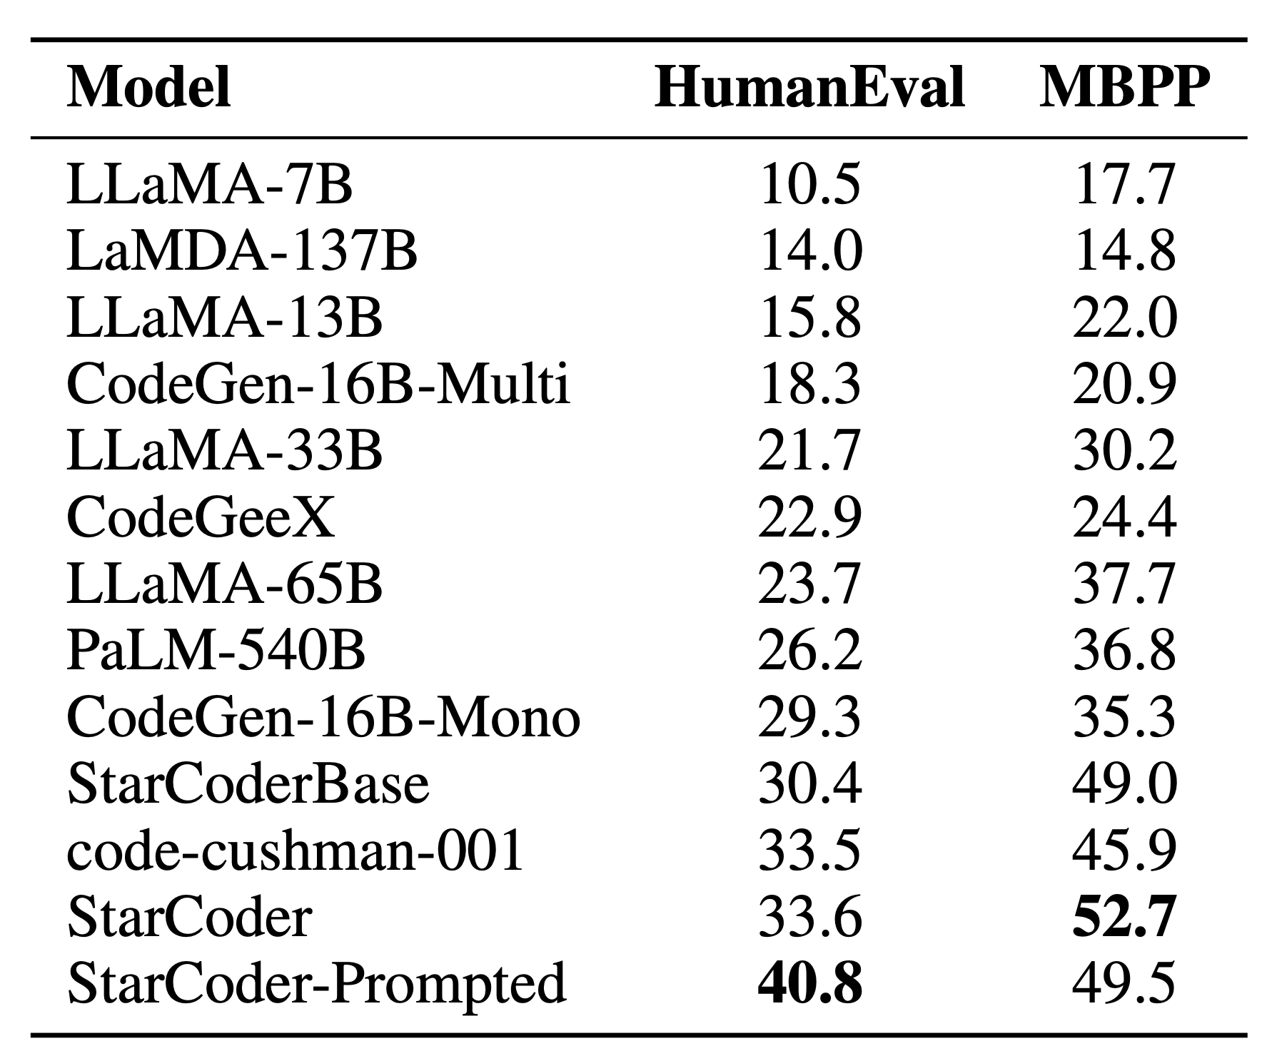
Functionality: Python Programming
HumanEval: 164 Python programming problems, originally used to evaluate Codex
MBPP (Mostly Basic Python Problems): around 1,000 “beginner” Python problems
StarCoder performs very well!
StarCoder-Prompted uses prompt: <filename>solutions/solution_1.py\n# Here is the correct implementation of the code exercise.

Slide 13
Functionality: Data Science
DS-1000 is a suite of 1000 realistic data science workflows across seven Python data science frameworks
Again, StarCoder or StarCoderBase has the best performance of tested models

Slide 14
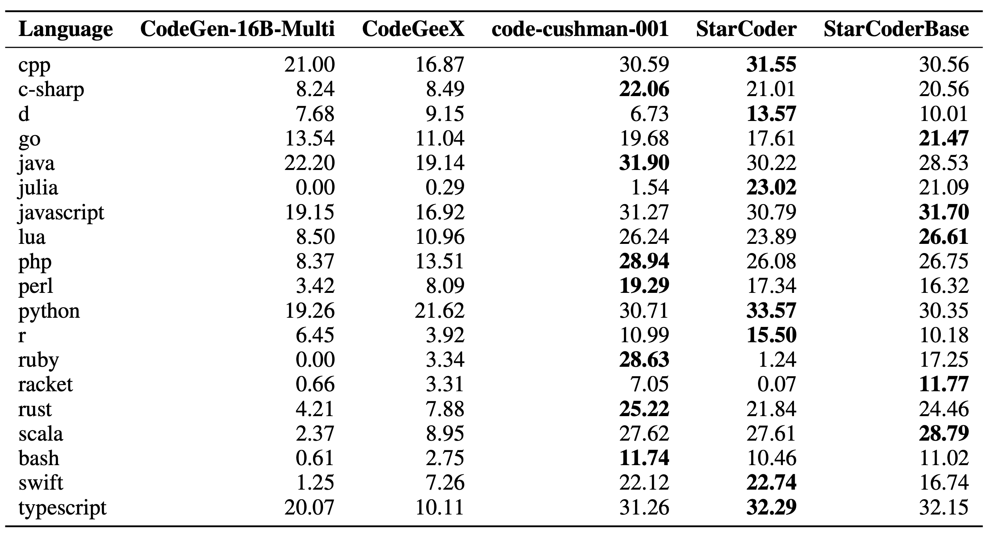
Functionality: Multilingual
MultiPL-E takes HumanEval and MBPP and translates the programs into 18 other languages
StarCoder beats existing open models, competitive with Codex Cushman

Slide 15
Security: C and Python
(This is the part I did)
Used the dataset created by Hammond Pearce et al. for our 2022 paper evaluating Copilot’s security, “Asleep at the Keyboard”
StarCoderBase does slightly better, but rates of insecure code generation are still high — and bigger models don’t seem to do better

Slide 16
Code Completion Playground
https://huggingface.co/spaces/bigcode/bigcode-playground

Slide 17
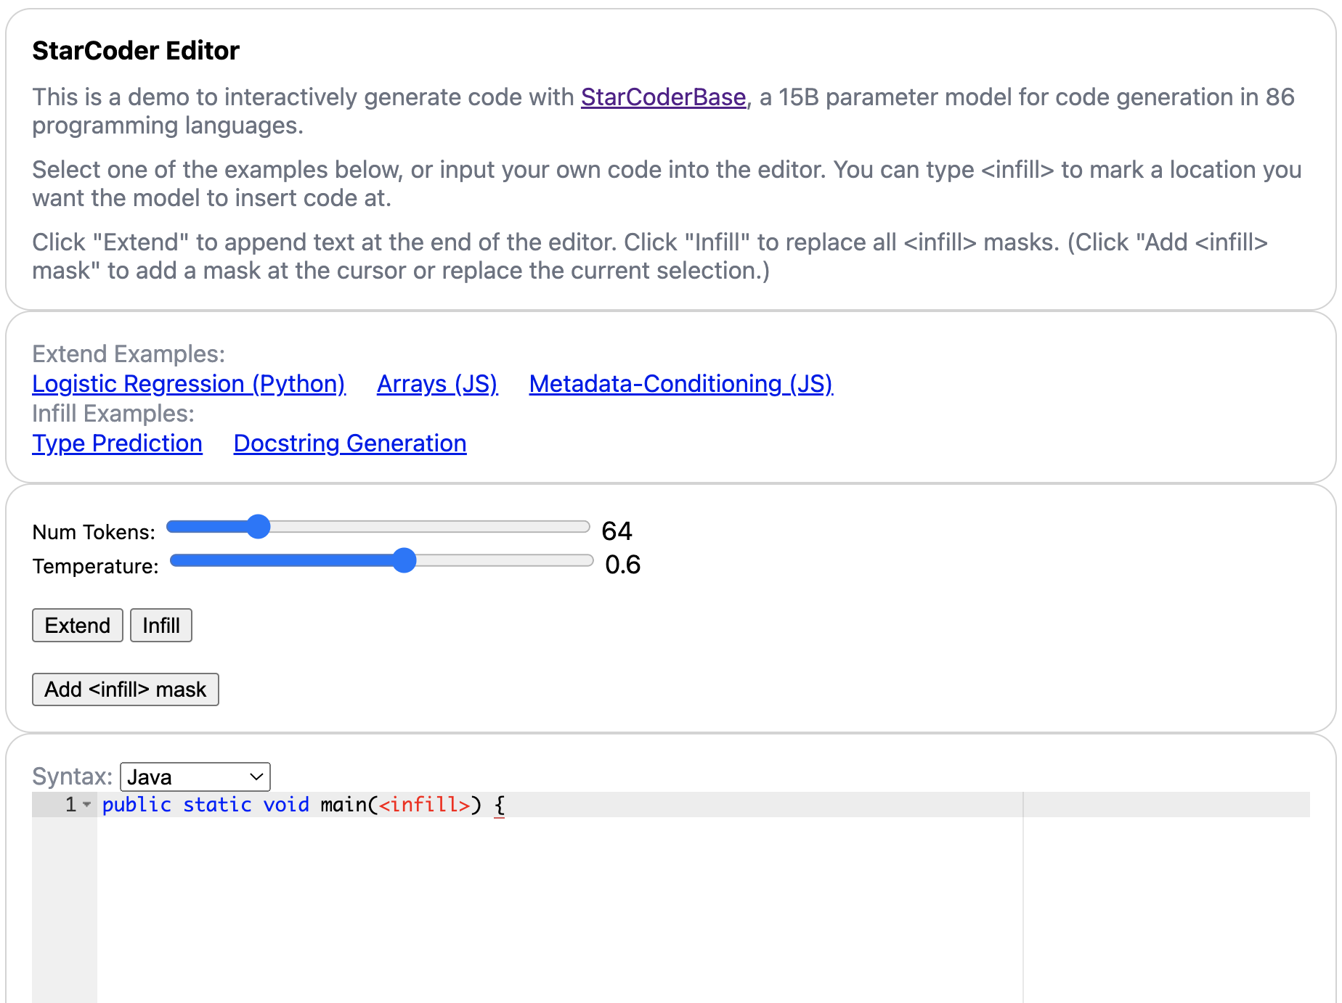
FIM Playground https://huggingface.co/spaces/bigcode/bigcode-editor

Slide 18
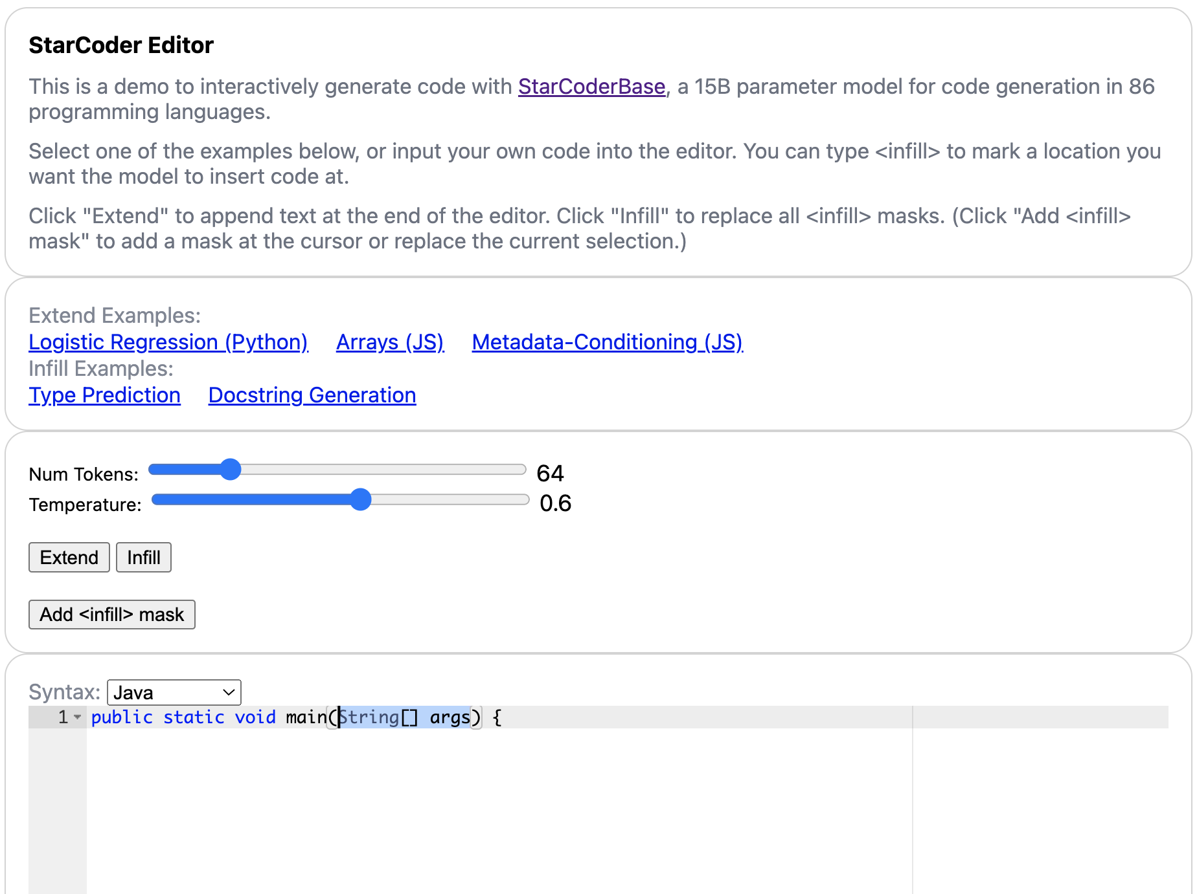
FIM Playground https://huggingface.co/spaces/bigcode/bigcode-editor

Slide 19
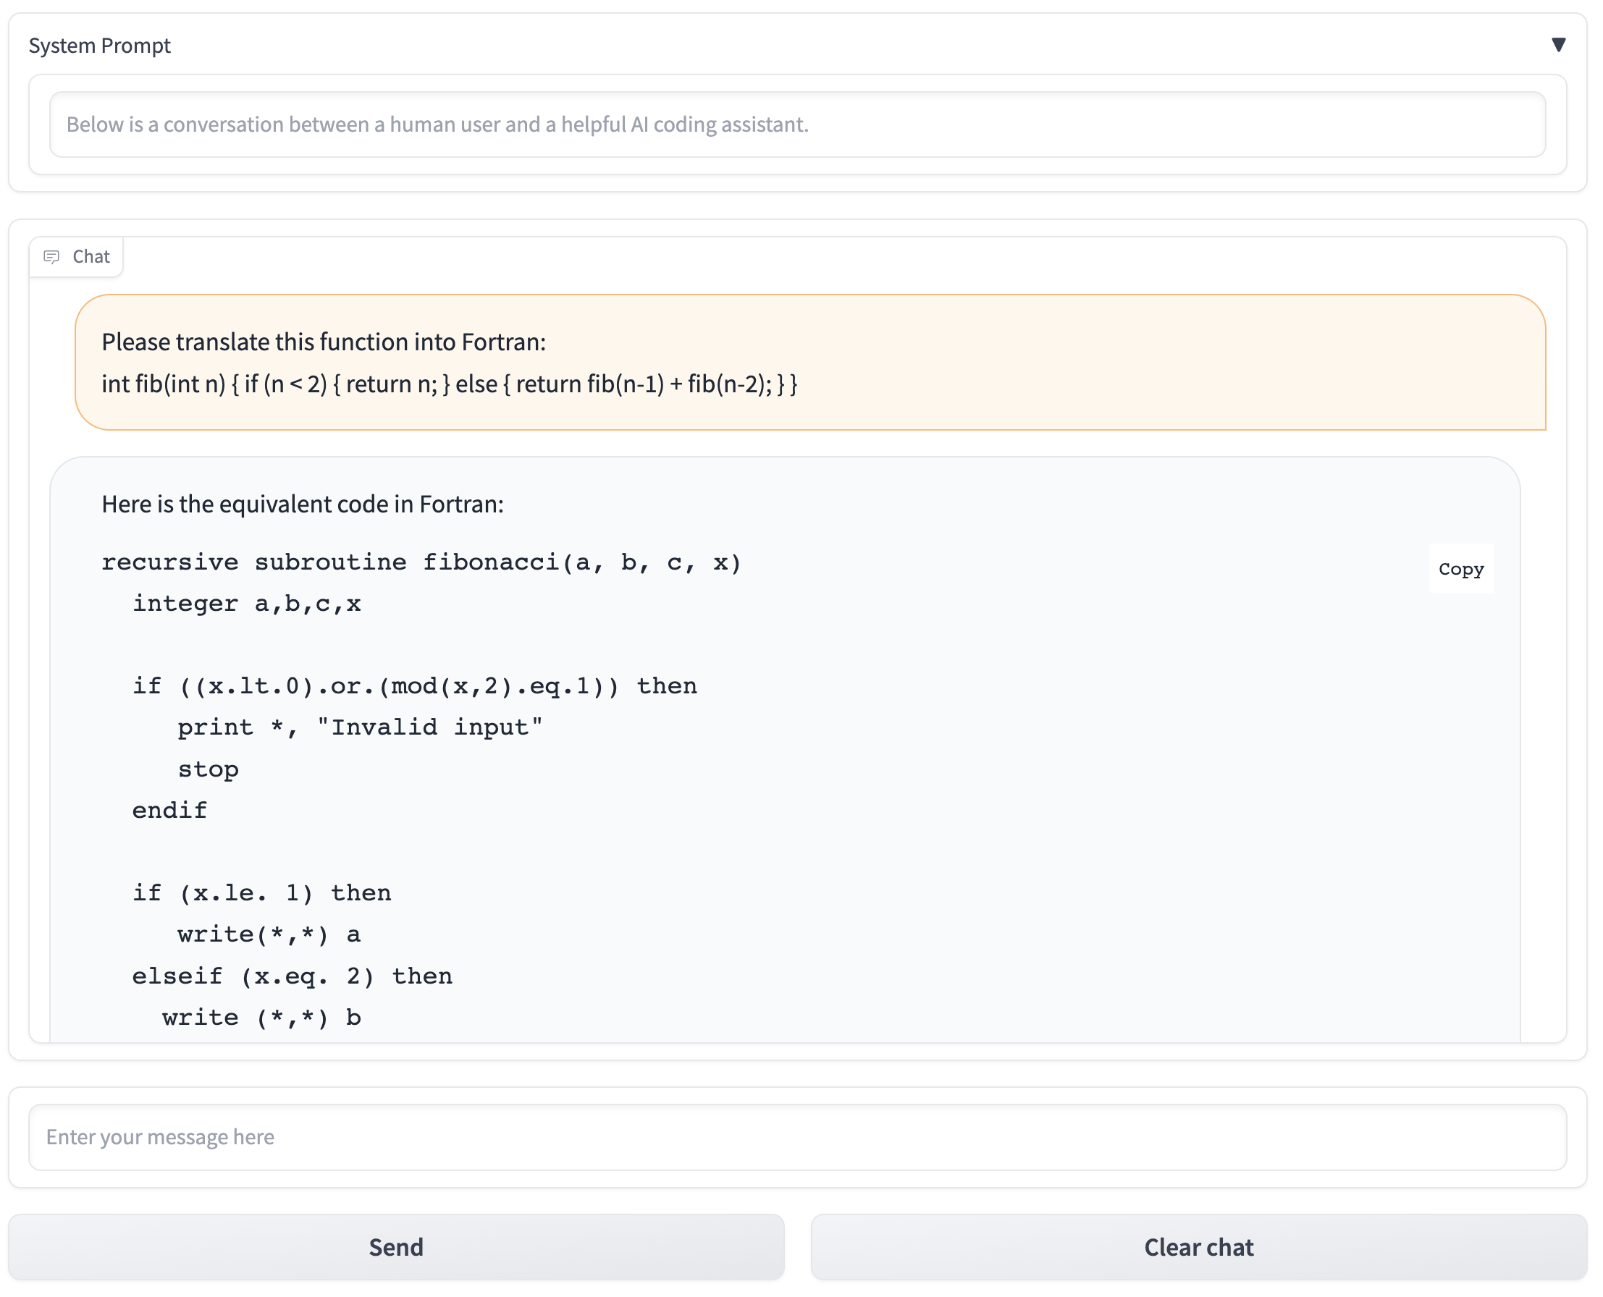
Chat With StarCoder
Variant of StarCoderBase, fine-tuned on instruction-following datasets (Dolly and OpenAssistant)
Allows the model to take natural language instructions, rather than just completing the prompt
https://huggingface.co/blog/starchat-alpha

Slide 20
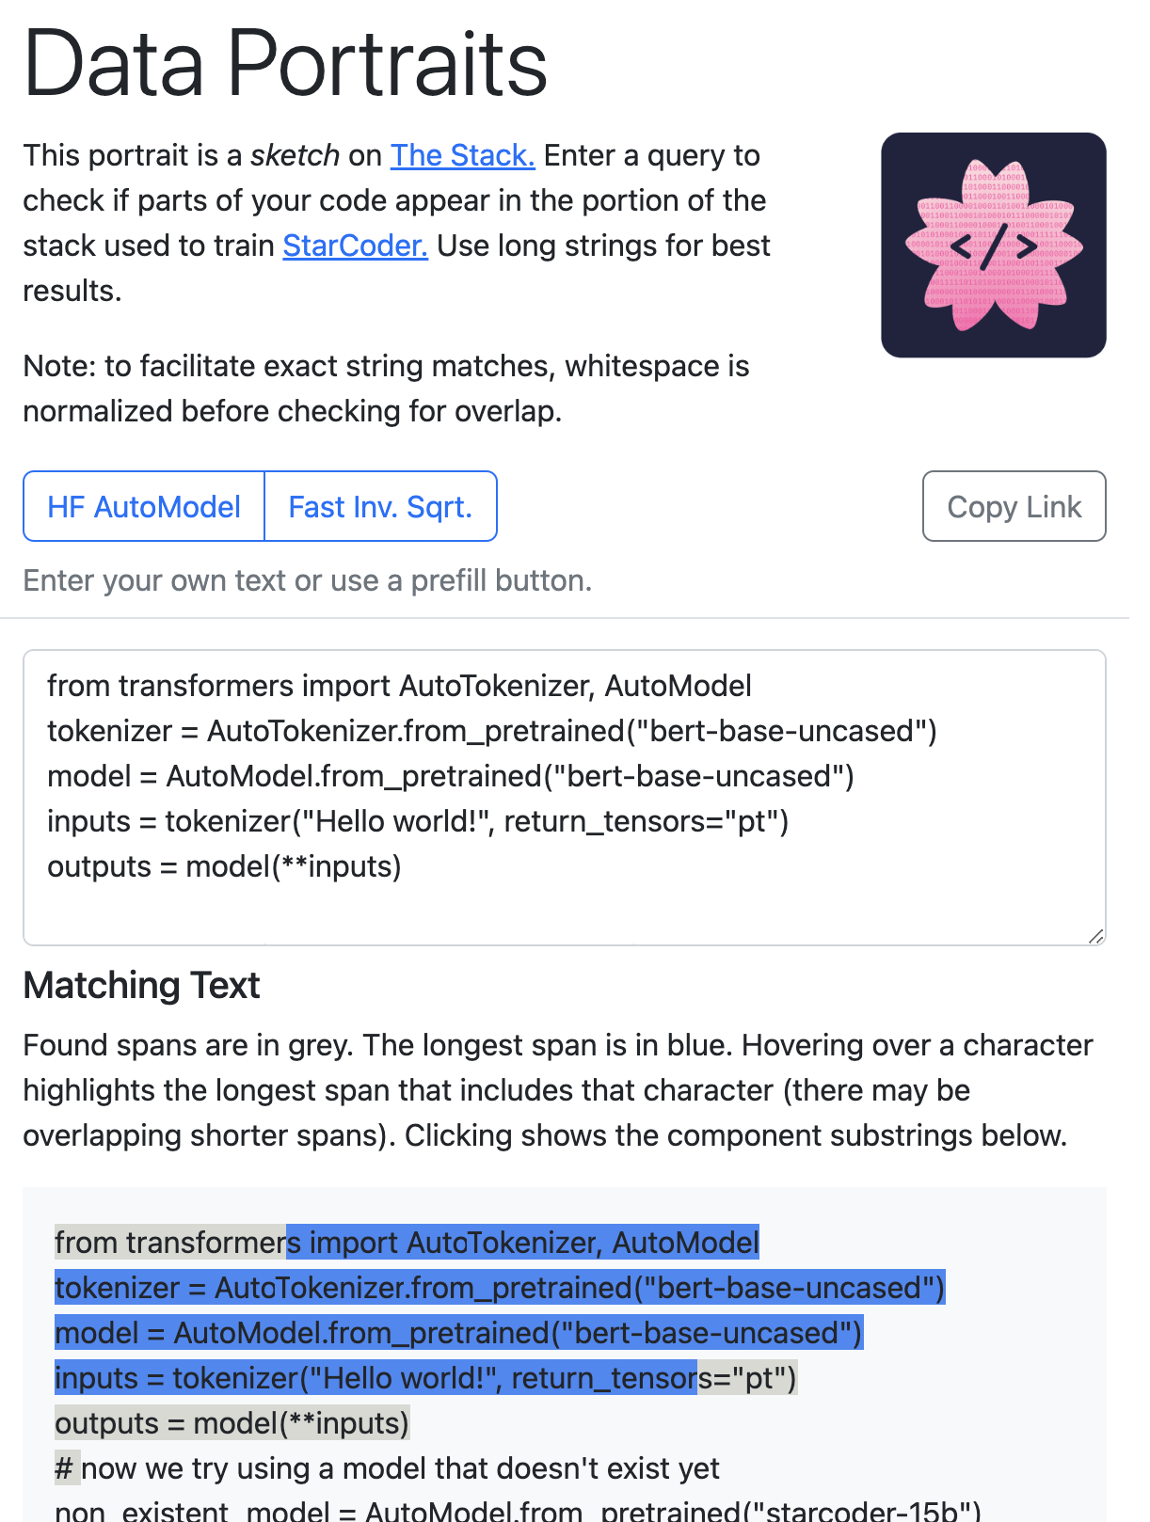
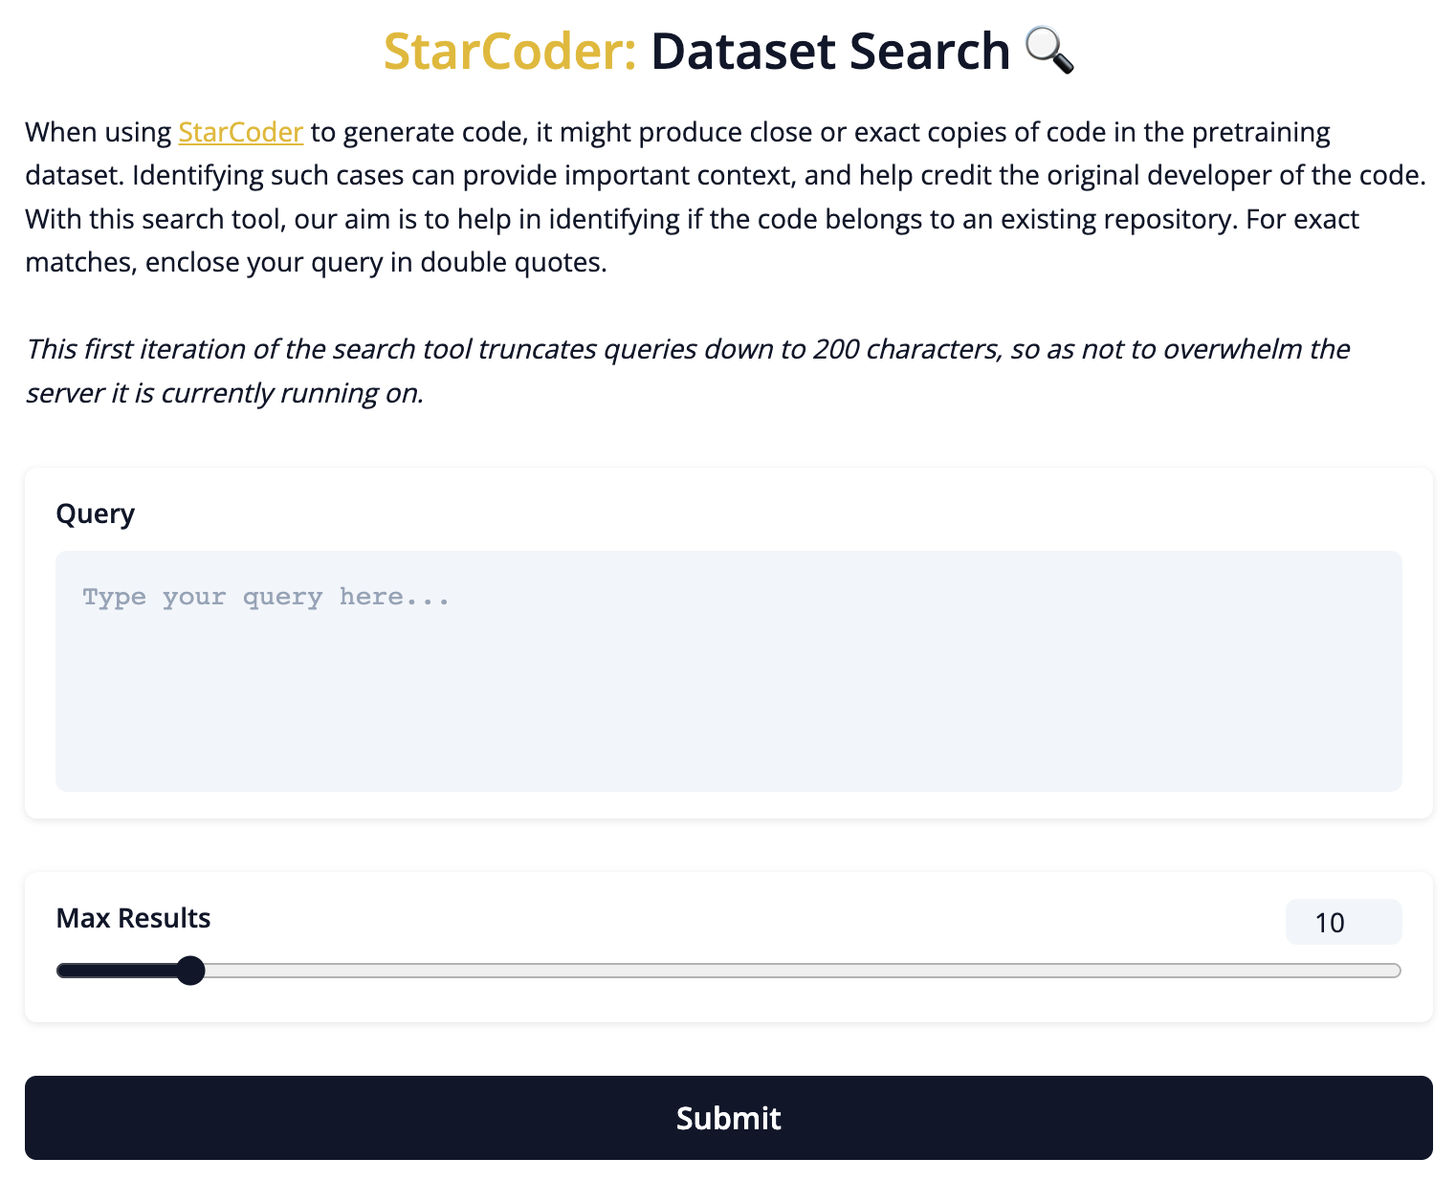
Attribution Tools
Fast Approximate Matching
Full-Text Search
https://huggingface.co/spaces/bigcode/search
https://stack.dataportraits.org/

Slide 21
Progress Marches Onward
The same week that StarCoder was released, three new open code models came out that also have strong performance:
Replit-v1.3b: a 2.7 billion parameter model trained on 20 languages using The Stack
Salesforce CodeGen2: the successor to the CodeGen models, with sizes ranging from 1B up to 16B parameters
Salesforce CodeT5+: an encoder-decoder code model with up to 16B parameters. The encoder can potentially be used for code embeddings.

